Slide 1

Contact details (e-mail id, mobile no, landline no.)
Company website URL/ link
vaibhav.maheshwari93@gmail.com
jPawansehrawat5909@gmail.com
Mobile no:-8894092617
Mobile no:-7836889751

Slide 2
Management Team
Pawan Sehrawat(Founder)
Vaibhav Kumar(Co-Founder)
Technical Team
Uttkarsh Chaurasia
Danish Sheikh
Swayam Kaul
Akshat Raj Vansh
Rishabh Dhenkawat
Saurabh Kumar Mishra

Slide 3
Issue / pain point addressed
Electric-Cycle based easy and daily commuting would be a great resource for injured and disabled users. Talking about my Institute, we have only one ambulance available in our campus so it is not always available. My teammate Vaibhav endured Slip-Discs last semester and was advised 3 weeks of bedrest but had to walk all the way from hostel to the lecture hall as there is no provision for attendance and sometimes ambulance wasn’t available.
Going outside the campus to the market is a headache as there are very few buses in Hamirpur and no proper services of auto or ola/uber. A bunch of auto-rickshaws and taxies do run here but charge extremely high.
Using our product will be a cost effective and time saving deal (most important aspect for students).
A very good resource for tourists who have come to enjoy in the hill stations but are always caught in traffic and don’t have an option of other easy mode of commuting.
Will reduce traffic in many tourist spots and other hill stations.
Pollution free mode of commuting.

Slide 4
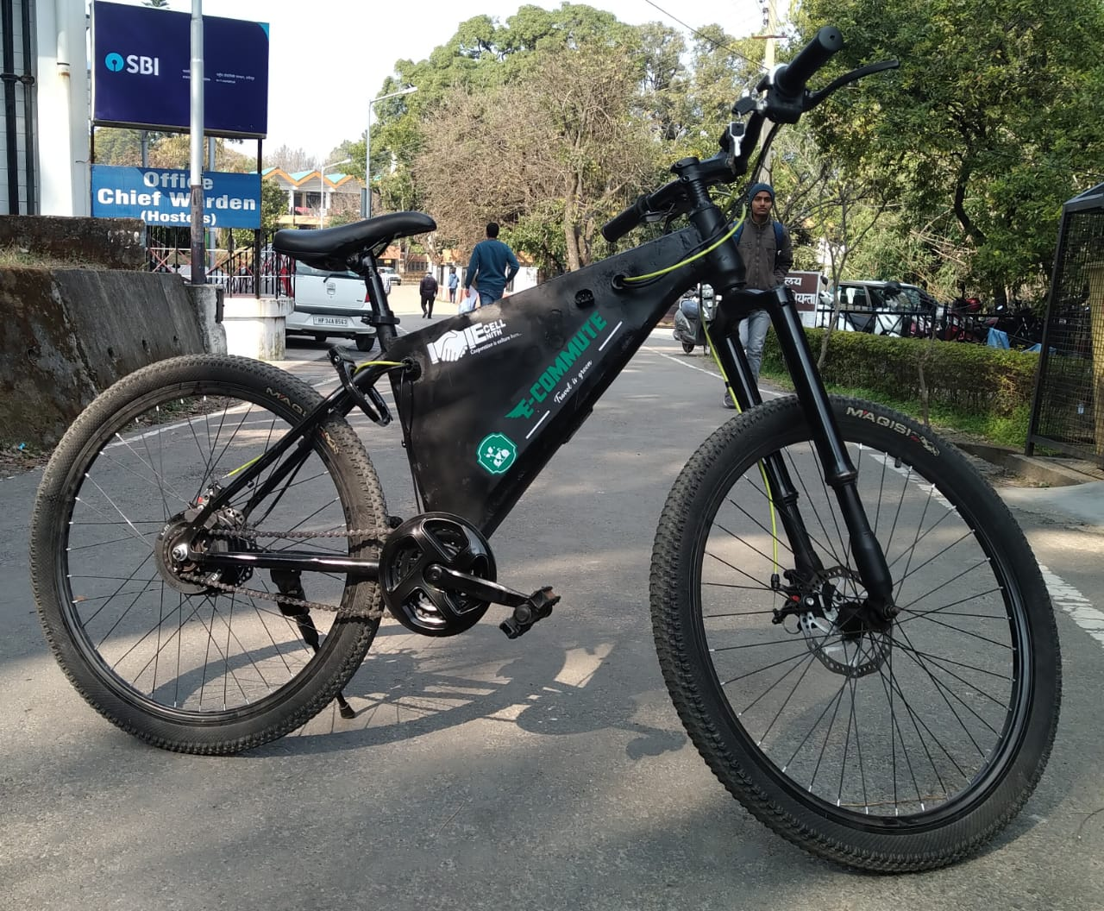
Product / Technology Overview
The E-cycle uses ‘250 W Hub motor’ which can provide up to 25 Km/h speed on throttle. Which can assist the user while pedaling on an inclined terrain.
The battery used in the cycle provides 70 Km/charge and has a charging time of 2 hrs. The bike handle also has a battery indicator mounted on it.
The cycle also has real time tracking system through which its real time location can be tracked when needed.
The locking mechanism is controlled through a mobile app with a unique feature of Temporary Lock System.
A self designed anti-theft system has been included which alerts the user on his/her phone and the concerned authority in case of theft attempt.

Slide 5
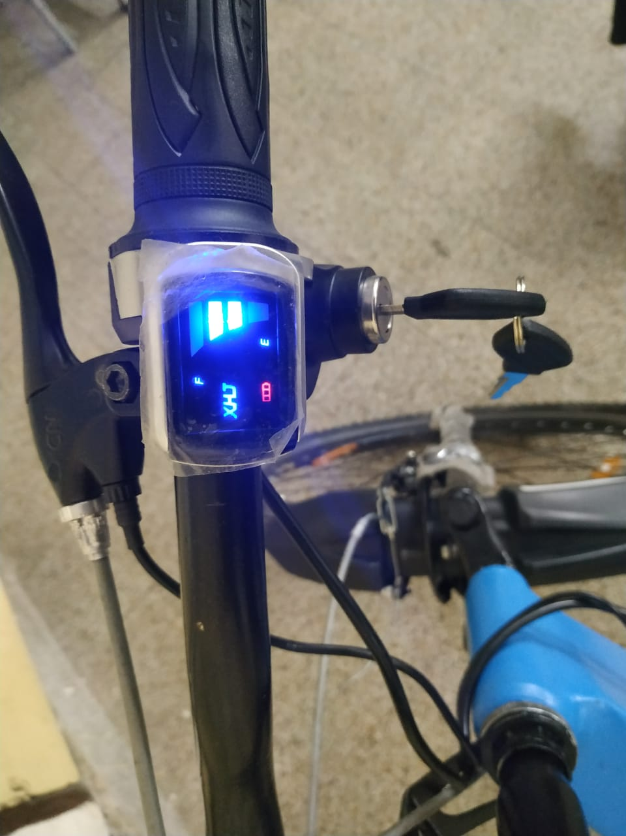
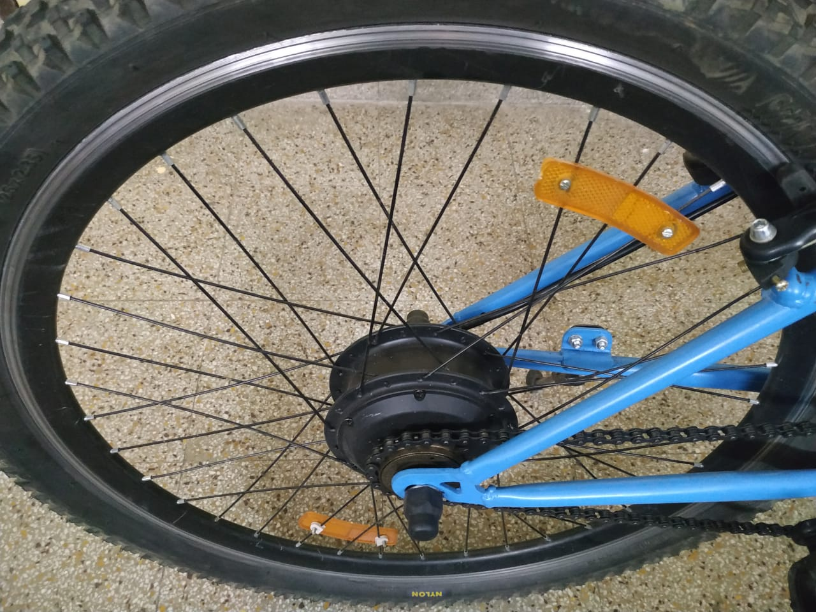
Electric cycle (E-commute)
Battery Indicator
250W Hub motor

Slide 6

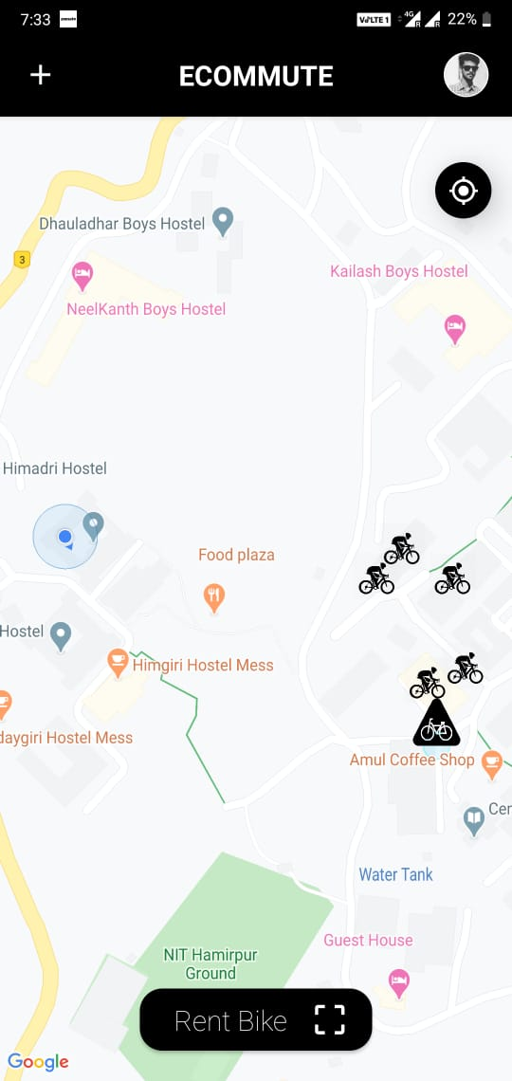
Mobile App
The mobile application has an interactive map user interface which shows the location of nearby available cycles.
The booking system is initiated by scanning the QR code placed on the bike through our app.
The ride can end only by parking the cycles in specific locations termed as ‘E-stations’(Dock less).

Slide 7
Business model
Pricing model (Following model is for NITH)
Bicycle unlocking charges: - ₨9(mandatory)
Short plan | Long plans
Rs1/minute | 1-hour plan: - Rs39
 | 2-hour plan: - Rs69
 | 3-hour plan: - Rs89
 | 12-hour plan: - Rs600
 | 24-hour plan: - Rs800
Pricing plans are dynamic and may vary depending on the target market.
What we have achieved so far – Our app is ready, pipeline for prototype development and related technologies has already been designed and successfully tested. Our prototype is ready and we just need fund for commercialization of our Start-Up.

Slide 8
Cash Flow
Undergiven analysis is for one academic year in NIT Hamirpur for 50 cycles only. The difference between Revenue and initial Investment increases as we scale the number of cycles.
Money Spent- Rs15lakhs (9,22,000 on 50 cycles, 1,50,000 for 6 E-Stations, 2,00,000 for Marketing).
Money Received(Revenue)- Rs17,28,000-Rs32,83,200 (For 8 months i.e. one academic year)
Profit after Break-even(for 1st academic year)=Rs2,28,000-Rs17,83,200
Profit for subsequent years(for every year)= approximately Rs17lakhs-Rs32lakhs.
If we successfully implement this business model in 10 colleges(considering similar market situation), then total Profit(for every subsequent year)= Rs1.70Cr-Rs3.20Cr.

Slide 9
Two year plan
We have developed the prototype and currently we are doing the testing for 1 month. The testing is being done to eliminate all the possible glitches from the project and now we are seeking for the funding of developing 50 samples for establishing it as our start-up in NIT Hamirpur.
We would ensure the successful operation of online renting of electric cycles by the students of our Institute.
Thereafter we would look forward to landing our feet in other Institutes and colleges of Himachal Pradesh starting from October, 2020 catering to the need of easy and economical travel in their place.
All this while we would be advancing our anti-theft by intensive research and integration of latest smart and secure technologies.
Once the market scanning and feasibility check is done, we would like to capture the tourist spots of Himachal Pradesh eliminating their difficulty of “Unavailability of cheap and easy commuting”. This begins around March, 2021.
We then would like to implement our business model in other hill stations of the country but its not the part of our Two Year Plan. We would implement this business model in other hill stations of the country after 2022.

Slide 10
Market size
Our target customers will be the students of all the educational institutes/colleges of Himachal Pradesh. Himachal houses 1056 Middle Schools, 1339 Secondary/Higher Secondary Schools, 64 General Colleges, 25 Medical Colleges, 1 Homeopathic medical college, 187 Engineering colleges and 16 Universities.
NIT Hamirpur itself houses 3500+ students and in total nearly 5000 students including IIIT Una students.
From a figure of 161.45 lakhs tourists in 2012-2013, the number of tourists visiting the State has now gone up to 196.02 lakhs in 2017-2018 and this is assumed to increase manifolds by 2022. -Himachal Pradesh CM, Jai Ram Thakur
Tourism is a humungous untapped market sphere for us which we aim to successfully capture by the world class commuting service we aim to provide.
Survey in NITH to analyze market scope

Slide 11
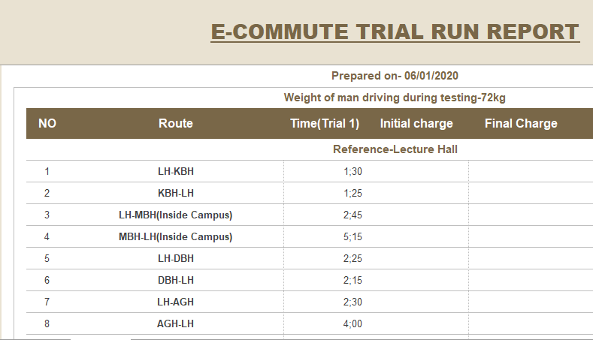
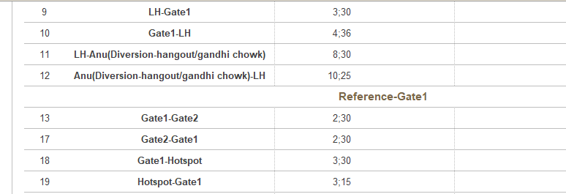
We measured time with our Electric bicycle inside and outside our campus.
To our surprise, any distance can be easily covered in less than 6 minutes without any drop of sweat dripping off of your body.
Time is extremely valuable for a student and our start-up would simply do justice to pain point we aim to address.

Slide 12
SWOT ANALYSIS
First dock less electric-bicycle sharing service in Himachal Pradesh. Extremely cost effective dock less stands(E-stations) using GPS technology. Very efficient self-designed anti-theft technology controlled using mobile application. 90% automated business model, trying to make it 100% automated. Environment friendly. Reduces motor vehicle congestion in crowded hilly regions thus reducing carbon emission & fuel consumption. | Inexperienced man power(available funds are not sufficient for hiring experienced staff). Capital needed for scaling, as cycles need to be purchased for expanding to other colleges & tourist destinations.
Normal cycles not effective in hilly regions. Severe shortage of daily commuting vehicles in colleges and other tourist spots in Himachal Pradesh. 161.45 Lakh tourists visited Himachal in 2012-2013 & 196.02 Lakh tourists in 2017-18, possibly it will grow more in the coming years. Colleges and Universities- 293 Middle school – 1056 Secondary & higher secondary schools – 1339 | “LETS PLAYY” is the only competitor we have in Himachal Pradesh, which follows entirely different business model than ours. They are not automated & their process for renting of electric-cycle is completely manual. Their service is only available in Manali & Bir (Himachal Pradesh).
STRENGTH WEAKNESS
OPPORTUNITY THREAT

Slide 13
Financials – current and projections
Total cost of the project and fund request- Rs15lakhs
Remaining Financial projection details covered in subsequent Slides.

Slide 14
Breakup of cost in Capex and Opex(According to 50 cycles)
CAPEX
OPEX
S.No. | Assets | Amt.
1. | Conversion Kits | Rs2,60,000
2. | Battery Manufacturing | Rs2,50,000
3. | Cycle Frame Dye Purchase | Rs75,000
4. | Frame+Painting+Stickers | Rs3,00,000
5. | PCB Designing and Manufacturing | Rs30,000
6. | Steel Sheets(8ft x 4ft) | Rs7,000
7. | Welders' one time expense | Rs10,000
8. | Anti-Theft equipments | Rs60,000
9. | Adapters | Rs80,000
10. | Shelters(Wireless Stations) | Rs2,00,000
11. | Cameras | Rs9,000
S.No. | Particulars | Amt.
1. | Telephone Bills(From Revenue) | -
2. | Internet Bills(From Revenue) | -
3. | Salary (From Revenue) | -
4. | Electricity Bills(From Revenue) | Rs7000/month
5. | Marketing Expenses | Rs1,80,000
6. | Sundry Expenses | Rs10,500
7. | Travelling and Market Scanning | -
8. | Transportation Charges | Rs20,000
9. | Website and App Hosting | Rs2000/month
10. | Maintenance & Repairs(From Revenue) | -
11. | Battery replacement (approx.1.5yrs life)(Re-sellable)(from revenue) | Rs1,25,000

Slide 15
Fund utilization plan with timeline
Purchasing 50 Lithium-Ion batteries.
Purchasing anti theft equipments.
PCB designing and manufacturing.
Frame Designing-based on area of Equipments inside battery box.(Should encapsulate efficiently all the hardware inside frame yet lightweight and charming)
Die manufacturing for our desired frame.(Includes sheet purchase also)
Manufacturing 50 frames.(Includes expense of box welding with frame)
Purchasing Conversion Kits(Motor, Microcontroller, Throttle, Battery Indicator) for 50 cycles.
Purchase of Adapters.
Transportation Charges.
Shelters‘(E-Stations) construction inside campus.
App/Website Registering/Hosting and server purchase.
Marketing.(Banners, Hoardings, SEO, Marketing Analytics)
Outreach expense.(Necessary for exposure to new age technologies for R&D optimization & Market Scanning for analysing our target customers and their necessities for Scaling of Business in future.)
Sundry Expenses.

